Slide 1
Waterjug problem
By
Sana Mateen

Slide 2
Problem Formulation
Problem formulation is a crucial step in problem solving. It involves deciding what actions and states to consider in order to find a solution.
There are four key components involved in formulating a problem: the initial state, successor function, goal test, and path cost.

Slide 3
Initial State
The initial state is the starting point of the problem-solving process.
It describes the possible situation from which the search begins for a solution.
Successor Function
The successor function describes the possible actions available . It determines which actions can be taken from a given state and what successor state will be reached as a result.
Goal Test
The goal test is used to determine whether a given state satisfies the desired goal.
Path Cost
The path cost assigns a numeric value to each path in the search space. It represents the cost or distance associated with traveling from one state to another. The path cost influences the search algorithm's decision-making process, as it aims to find the optimal solution with the minimum path cost.

Slide 4
Waterjug problem
The Water Jug Problem in Artificial Intelligence is a classic puzzle in AI and mathematics that focuses on optimizing the use of two or more water jugs to measure a specific quantity of water.
The problem involves two jugs, each with a different capacity.
The goal is to measure a specific amount of water using these jugs while adhering to certain rules and constraints.
The Water Jug Problem in AI involves constraints and objectives that make it a puzzle:
Constraint 1: The jugs have limited capacities.
Constraint 2: You can only fill or pour water between the jugs or from the source.
Objective: The goal is to measure a specific quantity of water accurately, typically by combining and transferring water between the jugs.

Slide 5
State Space and Action Space:
In AI problem-solving, we work with a state space (all possible states) and an action space (all possible actions).
In the Water Jug Problem, the state space comprises all possible configurations of water levels in the jugs.
The action space includes the actions you can take, such as filling a jug, emptying a jug, or pouring water from one jug to another.

Slide 6
Initial State, Goal State, and Actions:
The initial state is where you start. In the classic scenario, this typically means both jugs are empty.
The goal state is where you want to reach, representing the desired water level, e.g., 4 liters.
Actions are the operations you can perform on the jugs, such as filling, emptying, or pouring water between them.

Slide 7
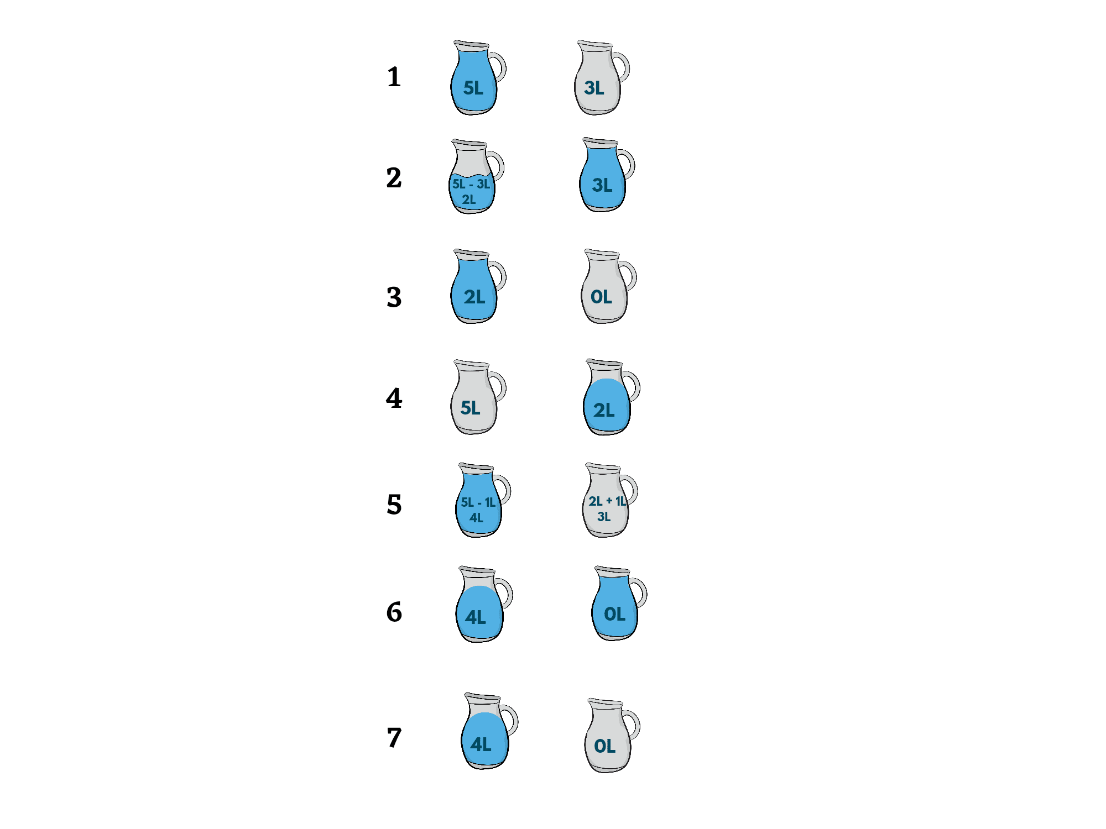
1.Fill Jug A Completely(Jug A:5)
2.Pour water from Jug A to Jug B until B is full.(Jug A:2,Jug B:3(as total capacity is 3))
3.Empty Jug B(Jug A:2 , Jug B:0)
4. Pour water from Jug A to Jug B(Jug A:0, Jug B:2)
5. AND 6. Fill Jug A completely and Pour water from A to B until it is full.(Jug A:4 ,Jug B:3)
7. Empty Jug B. Goal state reached as Jug A:4
Jug A: 5 Jug B:3
Initially: Jug A:0 Jug B:0
Goal state: Jug A:4 Jug B:0

Slide 8
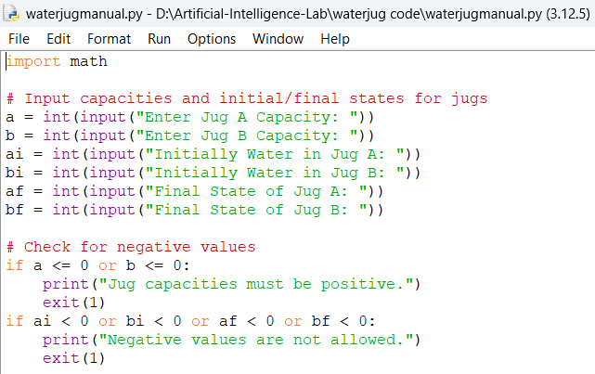
a and b: The capacities of Jug A and Jug B, meaning how much water each jug can hold.
ai and bi: The initial amount of water in Jug A and Jug B, which could be empty or partially filled.
af and bf: The target (or final) amount of water you want in Jug A and Jug B.
If the capacity of a jug (a or b) is less than or equal to 0, it is not valid because jugs must hold positive amounts of water.
If any of the initial or final water amounts (ai, bi, af, bf) are negative, it's not valid because you can't have negative amounts of water.
If any of these conditions fail, the program will print an error message and stop using exit(1).

Slide 9
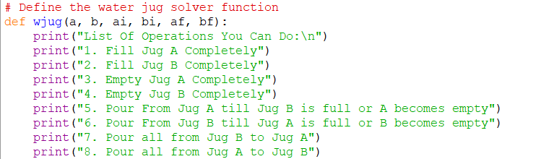

Slide 10
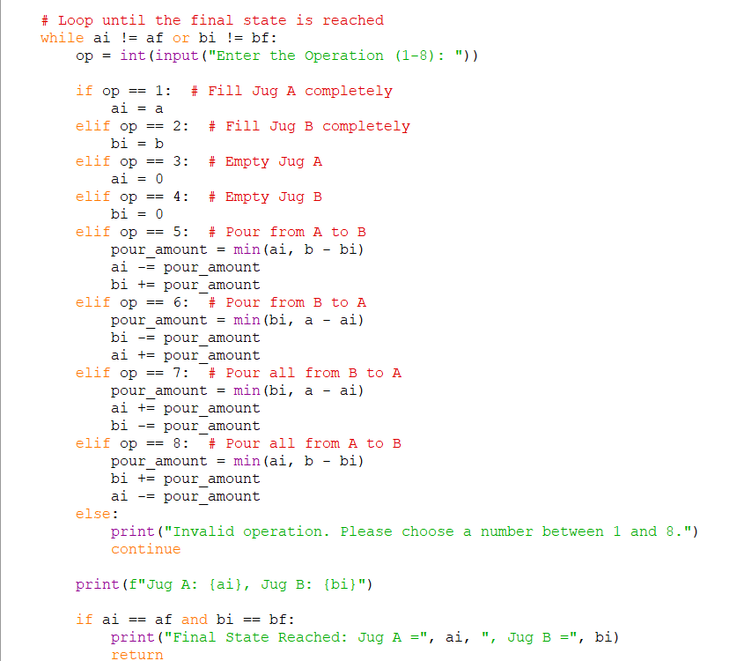
(0,0)
(0,3)
(3,0)
pour all from B to A
pour_amount=min(3,4-0)=3
ai=ai+pour_amount(ai=0+3=3)
bi=bi-pour_amount(bi=3-3=bi=0)
(3,3)
(4,2)
pour from B to A
pour_amount=min(3,4-3)=1
bi=bi-pour_amount=3-1=2
ai=ai+pour_amount=3+1=4
(0,2)

Slide 11
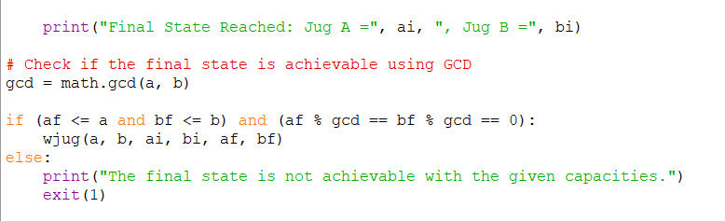
The GCD ensures that the desired final water amounts are physically possible with the given jug capacities.
If the final amounts are not multiples of the GCD, the problem has no solution, and we can avoid unnecessary calculations.

